Slide 1
Looking 20 Years into the Future The Southwestern Region's Strategic Plan
Briefing Presentation
The USDA is an equal opportunity provider, employer and lender.
Notes:
Background
In a rapidly changing world, country, and agency, and in a region as diverse as the 11 forests and grasslands of the Southwestern Region, the Regional Leadership Team decided to invest in a new strategic direction. From this investment has emerged a new vision statement, set of core beliefs, mission statement, and three areas of mission focus that will sufficiently inform our Regional priorities.

Slide 2
Contents
Why a Regional Strategic Plan........................3
Benefits of a Strategic Plan.......................4
SW Region Identity.............................................5
World Forces: Risks & Opportunities.................6
Regional Vision – Beliefs – Mission...................11
A new structure for Mission work....................14
Replacing the 3 Rs......................................15
3 Mission Focus Areas: Scale of Impact...16
Mission Objectives & Outcomes (21)…..20
Capacity Work: 7 core areas..........................24
Capacity Objectives & Outcomes (21)..32
Implementing the Strategic Plan....................34
In Closing...........................................................35

Slide 3
Why a Regional Strategic Plan?
Forces such as global environmental change are too big to face unit by unit
Changes on the land take decades, requiring a long view
A strategic plan gives us a common framework & touchstone
Aligns with & supports USDA and Forest Service direction
Notes:
Why a Regional Strategic Plan?
The Forest Service strategic plan provides broad direction, the Regional plan is more specific, based on our circumstances.
The Regional strategic plan:
Aids the Region in focusing work on the most critical issues within budget constraints.
Relieves workforce overwhelm.
Supports USDA and Forest Service plans.
Supports the RLT in advancing its strategic capability to collaboratively lead the Southwestern Region.
Partners: Although many of our partnerships are specific to a Forest or District, the Region realizes that with a bigger picture, we can be more efficient and effective in our work with others – whether this means sharing resources across Forest units, pursuing more efficient contracting vehicles, or engaging broader stakeholder groups in planning and decisions. The Strategic Plan enables leadership to ID priority areas, common issues, and shared Partner benefit.

Slide 4
Strategic Plan Benefits
Takes the long view (20 years)
Provides structure for ALL our work
Mission delivery work
Capacity building work
Establishes shared 3–5-year priorities
Is both durable and flexible
Notes:
Strategic Plan Benefits
Takes the long view (20 years)
Provides structure for ALL our work
Mission delivery work
Capacity building work
Establishes shared 3–5-year priorities
Is both durable and flexible
The development process:
The RLT began the planning process in Feb. 2021.
Completion: March 2022.
Forty RLT members, who change regularly, have been involved in the process.
A wide variety of perspectives are represented.

Slide 5
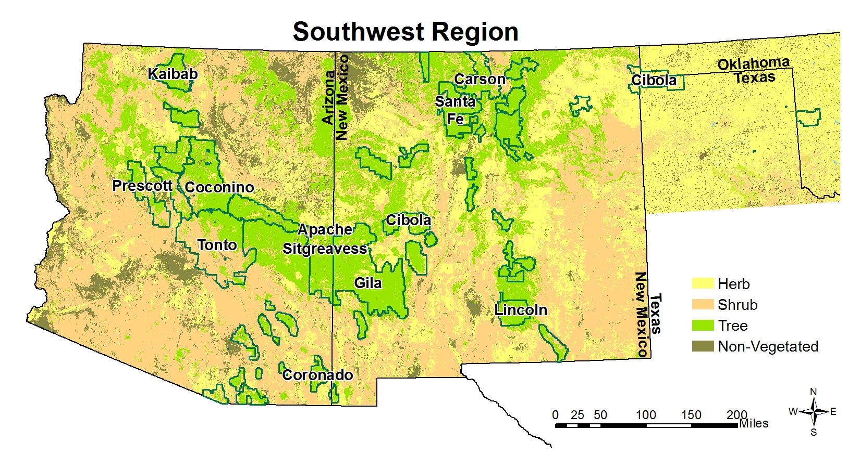
Southwestern Region Identity
As the public’s steward of National Forest System lands, the Southwestern Region is charged with balancing the many and often opposing perspectives with the long-term sustainability of the land.
The Aridity of the Southwest
Vast Diversity of Ecosystems
Long History of Communities
Diversity of Sovereign Nations
Notes:
Southwestern Region Identity
The aridity of the Southwest is a defining characteristic of this region and impacts every decision we make. This aridity means our wood supply is generally smaller and of lesser value in the existing marketplace, as compared to other regions.
The Southwestern Region is composed of a vast diversity of ecosystems, terrain, flora and fauna. This ecological diversity demands greater knowledge and the ability to move from one subject to another.
The long history of communities directly reliant on the resources of the national forests and grasslands demands a more responsive land management approach. The Southwestern Region must balance the multiple uses of the communities we serve.
There are 55 tribes and pueblos within the boundary of the Southwestern Region. The number and diversity of these sovereign nations demands a heightened awareness and understanding of the federal trust responsibility and how it relates to the day-to-day management of our forests and grasslands.
Partners: Living and working here in the southwest, you know these characteristics. Naming these specifically enables the Region to home in on work, policy and process that will improve how we do business with our communities & partners and advance what we can achieve together.

Slide 6
World Forces
World forces represent context and circumstances external to the region that together create the backdrop for all we do. As world forces change, we must reconsider our pathway forward
There are four major forces affecting our ability to carry out our mission and are critical for us to understand and describe as the starting point for this strategic plan
These forces hold both risks and opportunities, which the Plan describes to set the stage for the Region’s strategic direction
Notes:
World Forces
World forces represent context and circumstances external to the region that together create the backdrop for all we do. These forces affect our ability to carry out our mission and are critical for us to understand and describe as the starting point for this strategic plan. As world forces change, we must reconsider our pathway forward.
There are four ongoing and emerging trends that present formidable challenges to the Southwestern Region’s land management and public service responsibilities and impact our delivery of mission-critical work. These forces hold both risks and opportunities, which are described here to set the stage for the Region’s strategic direction.

Slide 7
Global Environmental Change
The pace and scale of global environmental change create risks and uncertainty for how best to fulfill the Forest Service’s mission
The vast land base of the SW Region serves as natural infrastructure that
mitigates climate change through biomass growth
captures, stores, and releases clean water
provides access to renewable energy and other resources for our communities
Notes:
Global environmental change
Examples to talk through as delivered.
Human-caused alterations to climate
Decreased plant biomass available for life forms
Loss of open space
Reduced options for plant and animal migrations
Proliferation of non-native species and diseases
Reduced water availability – a lynchpin of ecosystem resilience
All amplified by global climate change
Partners: the Forest Service is facing unprecedented change and impacts to the landscape, which demand we work with a longer view in mind. What we do on the landscape today affects resource health in the future. While we have always known this, the vast forces now in play mean we must think bigger and act on a broader scale. We need our Partners to help us see the whole landscape with the long view to ensuring its future.

Slide 8
Changing Relationship to the Natural World
People who are increasingly detached from the land do not see themselves needing it or having a role in stewarding it
With increased visitation—in many cases from first-time visitors—there is a significant opportunity for the Region to promote understanding of and connection to the land
Notes:
Changing relationship to the natural world
People’s relationship with nature is dynamic, constantly changing over time
Wildfires in the western United States and epic weather events in other parts of the country are highlighting the fragility of nature and the planet and the degree to which humanity relies on both, not just for recreation and spiritual renewal, but for survival.
Involving partners of all kinds enables us to reach the many diverse communities and peoples of the Southwest
Partners: we rely on our partners and the understanding and values we share in stewarding the land here. Not everyone is aware of the array of human impacts or the effects in a changing climate, but our partners do, and they help us spread the word through our growing communities.

Slide 9
Technology
The pace of new technology, applications, and devices outstrips the wheels of government
With technological advances come increasingly higher public expectations
As technology evolves, it’s essential for the Region to develop a culture in which rapid technological change is the norm, while continuing to bridge to communities with less access
Notes:
Technology
Big data (LiDAR, modeling) and crowd sourcing tools (Nature Mapping)
Workplace technologies, including smart offices, touch-free and remote work
Basic field functions, such as automated kiosks and self-cleaning toilets
Partners: Given that the government lags behind the private sector in its ability to procure new technologies, we often rely on our partners to supply not only the hardware but also the expertise in utilizing it.

Slide 10
Appropriations and Expectations
The Region has the opportunity to increase its agility regarding budget allocations
whether that means greater focus and innovative approaches during leaner funding cycles
or being prepared to fast-track initiatives that meet the requirements of specialized influxes of funding
Notes:
Appropriations and Expectations
Funding ebbs and flows, resulting in periods of flat budgets, and then in some years, Congress provides an influx of funding for specific initiatives
Partners: The Region’s access to and use of funds is an ever-shifting dynamic. With a Strategic Plan, the Region can be more agile in its approach, including our ability to work with partners to leverage funds and gain more on the ground.

Slide 11
Vision Statement
“The peoples of the iconic American Southwest care for its treasured landscapes as an essential and continuous legacy.”
Notes:
Vision Statement
Our vision statement: The peoples of the iconic American Southwest care for its treasured landscapes as an essential and continuous legacy.
This statement captures the fundamental importance of the many cultures that make up and interact in the Southwest.
It recognizes this place’s cherished status, not only for the people here, but for many around the world.
The vision statement’s aspiration is that those who know and love this land will ensure its ongoing existence into the future.
Partners: Our hope is that all the people who live and visit here become stewards of the land. Our partners are doing this and help us engage and teach others.

Slide 12
Core Beliefs
Water is the keystone of caring for the lands of the Southwest
Land stewardship evolves, anchored in science and place-based experience
Many voices balance multiple uses in service to resilient nature
Notes:
Core Beliefs
The Southwestern Region holds many values and beliefs that are both important to what we do and how we do it. Of these, there are three primary beliefs that serve as pillars for Region 3:
Water is the keystone of caring for the lands of the Southwest.
First and foremost, water is inseparable from all decisions and actions concerning the land. Its scarcity has defined life in the Southwest for eons and will continue to do so for the foreseeable future.
Land stewardship evolves, anchored in science and place-based experience.
Second, we understand that our decisions today have consequences for the future, which we may come to know only then. It is therefore essential that we learn from our actions and evolve what we know as an ongoing practice.
Many voices balance multiple uses in service to resilient nature.
Finally, our devotion to the land is based in our need for it. These needs are various and often competing so, through the involvement of many, our decisions are strengthened.
Partners: these core beliefs are so intrinsic to the work in the southwest, they are the foundation of everything we do. Water has always been the defining element of life here – our understanding of how to interact with the lands here changes as new generations come here and learn – and finally, the Forest Service is responsible for making wise decisions on the land not just for now but for future generations – this wisdom comes from involving others in these decisions.

Slide 13
Mission Statement
“As the public’s steward, we join forces with communities in the work of sustaining Southwestern forests and grasslands.”
Notes:
Mission Statement
Our mission statement: As the public’s steward, we join forces with communities in the work of sustaining southwestern forests and grasslands.
The mission statement captures the essential nature of the Forest Service’s role: that of service to the land on behalf of the American people.
Here in the Southwest, our interdependence is woven into the fabric of our storied history. We can only fully achieve our mission together with the people who live and visit here.
Partners: the Southwestern Region seeks active and effective partnerships with those who live and work here. The FS is the public’s steward of the land and is ultimately responsible for the decisions made, but our best and lasting work is the result of real engagement with communities and businesses.

Slide 14
Regional Vitality
National Prosperity
International Ecological Connection
The Region supports rural and urban communities and economies.
The Region’s resources contribute to the nation’s quality of life.
The Region’s landscapes advance the health of globally connected ecosystems.
A new structure for our work
Notes:
Mission Focus Areas
Regional vitality
National prosperity
International ecological connection
3 Mission Areas of Focus: Based on the scale of impact of our actions
Enables us to think bigger about the impacts of our work.
3Rs work is not done – it is fully integrated into this new structure.
Another advantage of this new structure based on scale of impact is how it benefits our workforce. By explicitly seeing the breadth and long-term effects of the Region’s work, our employees tap into a greater sense of purpose.
This includes how their work contributes to something bigger than themselves and even the communities in which they work.
This sense of mission and far-reaching purpose has the potential to motivate our workforce in entirely new ways, retaining and attracting the types of people the Region needs.
Partners: a core lens for our work is the scale of impact. This way of thinking means we are able to think specifically about a community, a landscape, or a species, while at the same time, remembering that whatever we do has impacts far greater than the place we put the shovel. We work here but what we do has contributions and impacts to the entire southwest, to the Nation and even to the globe, as water, migratory species, pollinators, seeds and more move across the boundaries of place.

Slide 15
Replacing the 3 Rs [DELETE]
Served us well for the past 5 years
Time for something new
3Rs work is not done – it is integrated into the new structure
Three New Mission Areas of Focus
Based on the scale of impact of our actions
Enables us to think bigger about the impacts of our work
Gives workforce a greater sense of purpose
Notes:
DELETE THIS SLIDE FOR PARTNERS
Replacing the 3Rs
The 3Rs gave us a collective focus that was simple, catchy & memorable but they were both overbroad and not inclusive enough. It was time to revisit them.
Served us well for the past 5 years.
Time for something new.
The RLT considered various options – we wanted them to be:
Inclusive: ALL mission work could fall under them.
Strategic: They support us to think bigger with a focus on the future.
Aspirational: They inspire us to consider the contribution we make to our region, the country, and to the world’s ecology with every decision and action.

Slide 16
Regional Vitality
The Region supports rural and urban communities and economies.
Notes:
Regional Vitality
Region 3 supports rural and urban communities and economies.
This regional focus area covers most of what the public sees of our work, and as a result, is perhaps the most familiar of the three areas of mission focus.
This focus area is an integrated set of objectives that represent the work we focus on across the Southwestern Region – the activities that specifically benefit the Region’s landscapes, communities, and businesses.
The Southwestern Region of the Forest Service is committed to serving both rural and urban communities and to bridging their broad range of interests, which includes a reliance (even if unconscious) on the ecosystem services (air, water, soils) generated by public lands.
In particular, the US Forest Service is attentive to benefitting traditionally disadvantaged and underserved communities wherever possible, especially those at greater risk of ecological changes and lacking adaptive capacity.
Partners: [this one should be obvious, assuming most partners work in a particular area of the region – so give whatever examples make sense for the partner(s) you are addressing]

Slide 17
National Prosperity
The Region’s resources contribute to the nation’s quality of life.
Notes:
National Prosperity
Region 3’s resources contribute to the nation’s quality of life.
This area of focus is critical to increase public understanding of the Forest Service’s multiple use mandate, the resulting decisions and actions, and the opportunities for innovation that reduce the impacts from these uses.
This focus area daylights the big resource contributions the Region is expected to make for the benefit of the nation. This is major work that may be controversial or invisible to much of the public, but that is required, both in terms of the agency’s mandate and in terms of supporting the country.
For instance, issuing special use permits for mining, energy development or tele-communications is time-intensive and often contentious, but all these activities are required by the Forest Service’s authorizing legislation and demanded by our current rate of consumption.
Partners: It’s important to remember that this region of the Forest Service is expected to make a broader contribution to the country – that contribution is specific to this area. For example, our wood supply is quite different from that of other regions. In addition to resources, this Region also provides iconic landscapes and species such as the Saguaro cactus that are part of the American experience.

Slide 18
International Ecological Connection
The Region’s landscapes advance the health of globally connected ecosystems.
Notes:
International Ecological Connection
R3’s landscapes advance the health of globally connected ecosystems.
The scale of ecological change now is global, so to meaningfully respond to the effects of climate change, we must work across international boundaries with approaches tuned to this scale.
This focus area provides for work at the larger ecological scale demanded by climate change and its impacts (e.g., migration corridors, waterways, and contiguous soils), as well as for partnering with others at this scale.
The Sonoran Desert and our Madrean Pine-Oak Woodlands are examples of important and treasured ecosystems that span international borders, as watersheds are examples of vital resources that cross boundaries with Tribes, Pueblos, land grant communities and acequias.
An added benefit of this focus area is an expanded mindset for the Region in how we engage the vital sovereign entities of the southwest with whom we share land stewardship responsibility, no matter in which focus area the work falls.
Partners: we can tend to forget that the globe is one large system that ebbs and flows, but our waterways and winds remind us that what we do here affects over there. This means we must focus on cross-border work to ensure that this vital movement of the environment is not impeded unnecessarily.

Slide 19
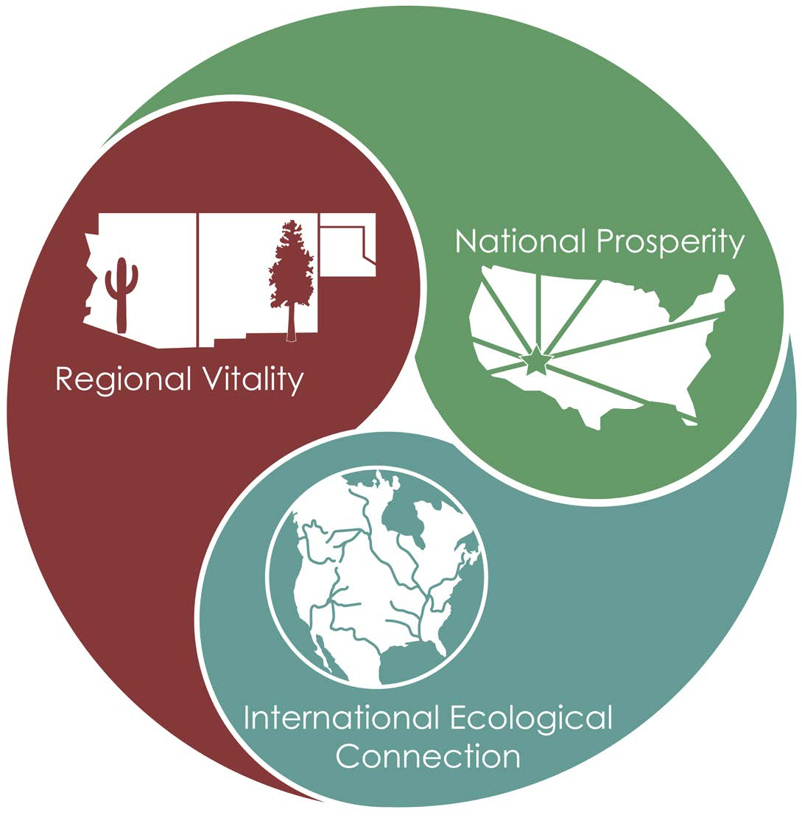
New Focus Areas Benefits
Encompass all the work we do – now and into the future
Enable the Region to balance the local with the global
Helps us be intentional about the long-term results of our actions
Our employees [and partners] tap into a greater sense of purpose
Notes:
[RRC: Suggest adding the yellow highlight or delete this slide.]

Slide 20
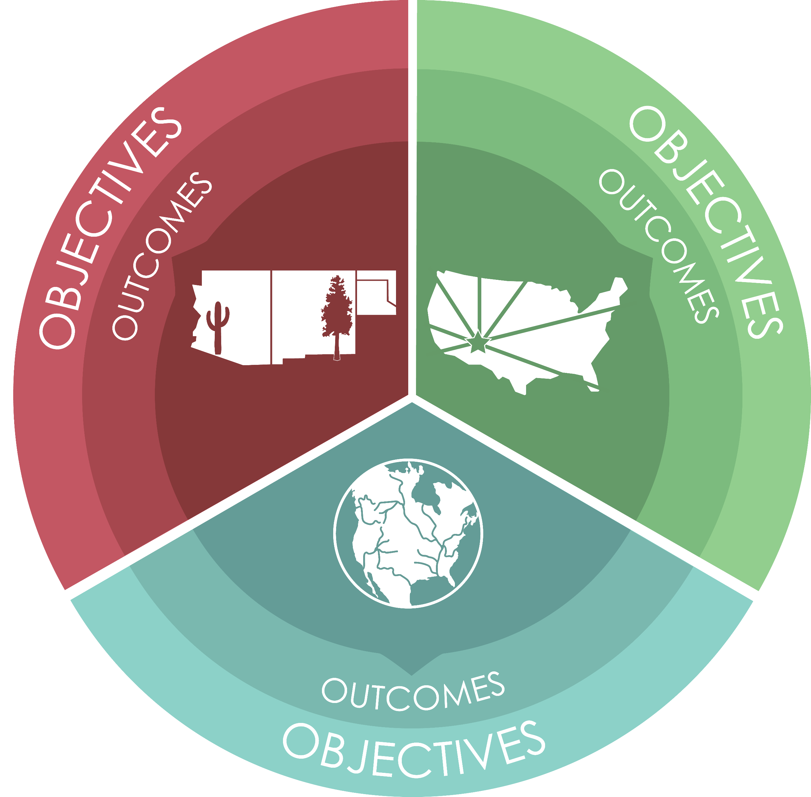
Mission Work
The work we do that the public sees and expects
Objectives & Outcomes
Objectives spread across the 3 focus areas: 10–20-year time
Each Objective has associated 3–5-year Outcomes (21)
Notes:
Mission Objectives and Outcomes
Within each of these focus areas are 21 objectives and outcomes that reflect the role and priorities of the Region. While 21 outcomes may appear to add to an already full plate of activities, in fact, these outcomes provide clear direction and focus for already ongoing work, so that major achievements may be accomplished collectively.
Mission: The work that we do that the public sees and expects.
Objective: Longer term (10-20 years)
Outcome: Shorter term (3-5 years)
Our workforce needs to experience accomplishing something – so we set very specific, achievable outcomes.
We can achieve these outcomes in 3-5 years as a Region. This will give us all a sense of accomplishment and purpose.
These are not meant to be one and done. As we accomplish outcomes, we will add the next set and keep moving toward achieving the longer-term Objectives.

Slide 21
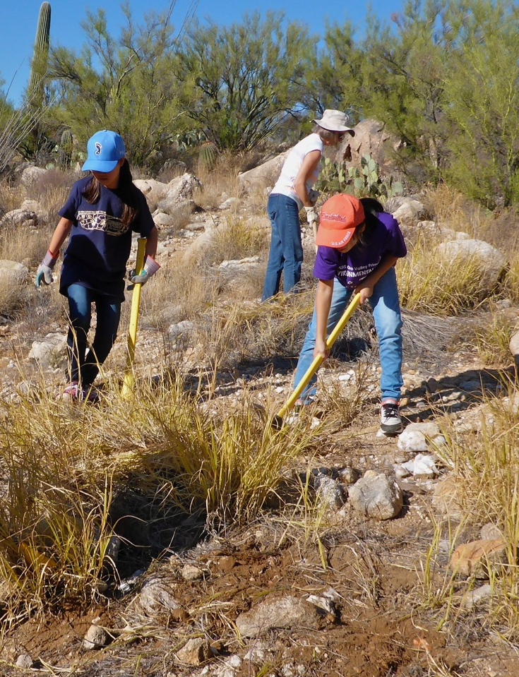
Sample Mission Objective/Outcome: Regional Vitality
Obj I. 1: Ecosystem structure fosters disturbance processes that play their ecological role. By 2042
Outcome A (5 years): Forest structure in priority firesheds is such that fire behavior is within its desired regime.
Explanation: the intent here is that the Region will identify its priority firesheds from existing data sources – including work with States, partners and others, and this will narrow the outcome sufficiently to accomplish it. Also, forest structure will determine appropriate fire regime.
Outcome B (3 years): Naturally intact desert areas are free from invasive grasses such that fire does not spread.
Explanation: the fragility of deserts and their threat from fire carried by invasive grasses is the core of this outcome. Identification of naturally intact desert areas is a requirement of this outcome.
Notes:
Example from the Regional Vitality focus area:
Objective I. 1: Ecosystem structure fosters disturbance processes that play their ecological role by 2042.
Outcome A (5 years):
Forest structure in priority firesheds is such that fire behavior is within its desired regime.
Explanation: the intent here is that the Region will identify its priority firesheds from existing data sources – including work with States, partners and others, and this will narrow the outcome sufficiently to accomplish it. Also, forest structure will determine appropriate fire regime.
Outcome B (3 yrs): Naturally intact desert areas are free from invasive grasses such that fire does not spread.
Explanation: the fragility of deserts and their threat from fire carried by invasive grasses is the core of this outcome. Identification of naturally intact desert areas is a requirement of this outcome.
Partners: [Add in Mission Obj/Outcome examples that are relevant to them. Replace the ones currently in the PPT, if appropriate to the Partners. – then explain the Objective (10-20 yrs) and the Outcome (3-5 years) as they related to the Partner.]

Slide 22
Sample Mission Objective/Outcome: National Prosperity
Obj II. 2: The Region’s wood supply is an established choice in the marketplace. By 2035
Outcome B (5 yrs): The Region’s wood products advance emerging markets for underutilized material.
Explanation: Given the region’s aridity, our wood supply is smaller and of lesser value in the current marketplace; this outcome is about connecting with and supporting innovation that leads to new markets for products that utilize our supply.
Notes:
Example from the National Prosperity focus area:
Objective II. 2: The Region’s wood supply is an established choice in the marketplace by 2035.
Outcome B (5 years): The Region’s wood products advance emerging markets for underutilized material.
Explanation: Given the region’s aridity, our wood supply is smaller and of lesser value in the current marketplace; this outcome is about connecting with and supporting innovation that leads to new markets for products that utilize our supply.
Partners: [Add in Mission Obj/Outcome examples that are relevant to them. Replace the ones currently in the PPT, if appropriate to the Partners. – then explain the Objective (10-20 yrs) and the Outcome (3-5 years) as they related to the Partner.]

Slide 23
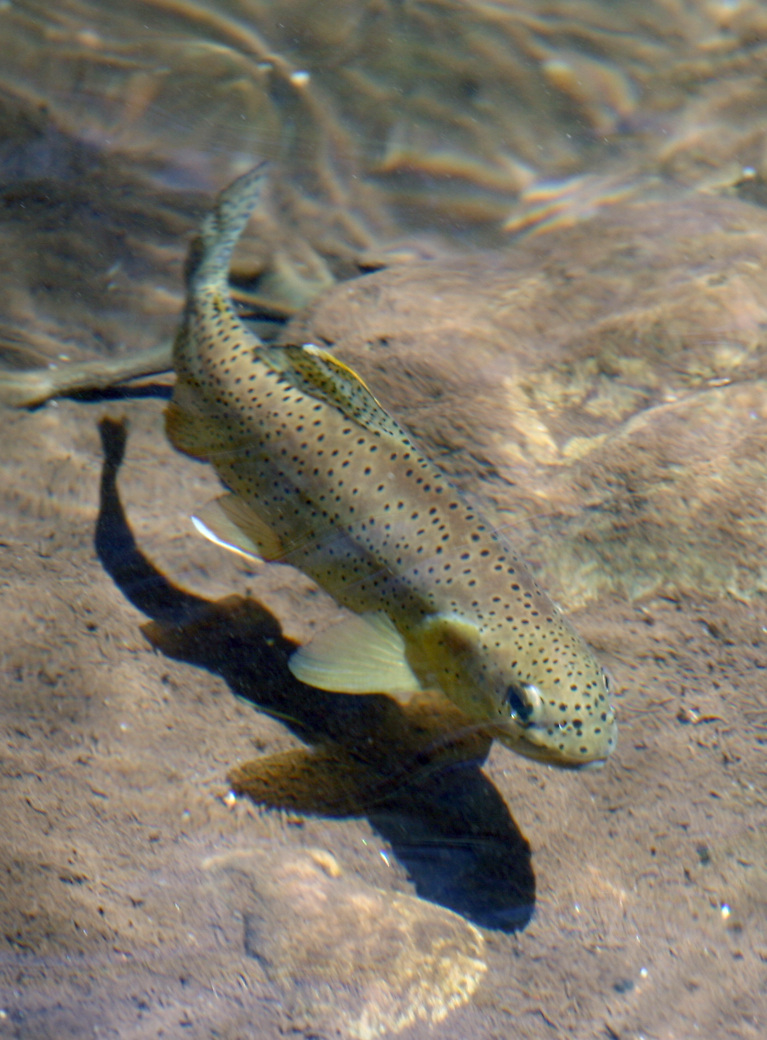
Sample Objective/Outcome: International Ecological Connection
Obj III. 4: Aquatic habitats that function as corridors and refugia for biodiversity thrive. By 2042
Outcome E (5 yrs): Unintended physical barriers to aquatic T&E species movement and dispersal are modified to allow passage.
Explanation: some physical barriers to species dispersal and migration are intentional, however, the focus of this outcome is on identifying and removing Forest Service-caused infrastructure that undesirably prevents aquatic species passage.
Notes:
Example from the International Ecological Connection focus area:
Objective III. 4: Aquatic habitats that function as corridors and refugia for biodiversity thrive by 2042.
Outcome E (5 years): Unintended physical barriers to aquatic threatened and endangered species movement and dispersal are modified to allow passage.
Explanation: some physical barriers to species dispersal and migration are intentional, however, the focus of this outcome is on identifying and removing Forest Service-caused infrastructure that undesirably prevents aquatic species passage.
Partners: [Add in Mission Obj/Outcome examples that are relevant to them. Replace the ones currently in the PPT, if appropriate to the Partners. – then explain the Objective (10-20 yrs) and the Outcome (3-5 years) as they related to the Partner.]

Slide 24
Capacity Development
What we need to build our ability to achieve our mission goals – our Partners help us with this!
7 Core Areas of Capacity
Workforce – including Partners
Funding – including Partner funds
Infrastructure – including what Partners help us maintain
Technology – including the assets our Partners provide
Image – including the added visibility we garner through our Partners
Governance – including the Plans, Policies & Agreements we develop with Partners
Knowledge – including the expertise our Partners bring
Workforce
Knowledge
Funding
Governance
Infrastructure
Image
Technology
Notes:
Capacity
Capacity: The work that we do to achieve our mission goals that the public doesn’t generally see.
Capacity is a requisite to achieve strategic goals. This strategic plan considers the Region’s current capacity in seven core areas.
Capacity work is about building the region’s ability to accomplish mission outcomes. Both capacity and mission work are vital to the success of the Region, and it is leadership’s responsibility to ensure a sufficient balance between the two.
Normally, we think of capacity as being workforce and funding, but in this planning process, we looked at five other areas of our capacity that we, as a Region, have control over.
The seven core capacity areas are:
Partners: RRC edited this slide for a Partner focus. Consider keeping one or two of slides below that dive deeper into each of the 7 capacity areas, if the Partners specifically support in that area.

Slide 25
Workforce
Of all the areas of capacity, workforce is the Region’s most important and valued
The people who work for the Region actualize each day
The work ethic
The relationship with our communities
The stewardship of the land that together make up the character of the Forest Service’s Southwestern Region
The many aspects of maintaining an optimal workforce in the Region, from recruitment and hiring to professional development, safety, morale, efficiency and so much more
Notes:
Workforce
Of all the areas of capacity, workforce is the Region’s most important and valued.
The people who work for the Region actualize each day the work ethic, the relationship with our communities, and the stewardship of the land that together make up the character of the Forest Service’s Southwestern Region.
This capacity area involves the many aspects of maintaining an optimal workforce in the Region, from recruitment and hiring to professional development, safety, morale, efficiency and so much more.
Not only do we think about workforce as those who are with us now, but also as an opportunity for others who will come, bringing rich experience from varied backgrounds.
The workforce capacity area is fundamental to our ability to accomplish everything in the Strategic Plan.
Partners: DELETE UNLESS THE PARTNER ADDS TO THIS AREA – if the Partner does, then develop TPs specifically to address their contribution and how it could be expanded.

Slide 26
Funding
Funding is a constantly shifting resource, necessitating a high level of agility to move with its ebbs and flows
This Strategic Plan was, in part, prompted by shifts in the Agency’s budgeting and accounting process and the Region’s desire to build a collective, long-term strategy to enable a nimbler stance in relation to shifts in funding opportunities
The range of issues related to funding, including allocations, accounting, tracking and reporting
Notes:
Funding
Funding is a constantly shifting resource, necessitating a high level of agility to move with its ebbs and flows.
This capacity area covers the range of issues related to funding, including accounting, allocations, tracking and reporting.
This Strategic Plan was, in part, prompted by shifts in the Agency’s budgeting and accounting process and the Region’s desire to build a collective, long-term strategy to enable a nimbler stance in relation to shifts in funding opportunities.
Partners: DELETE UNLESS THE PARTNER ADDS TO THIS AREA – if the Partner does, then develop TPs specifically to address their contribution and how it could be expanded.

Slide 27
Infrastructure
The Region’s infrastructure capacity area addresses all the physical assets of the Region that support its mission work
The Region’s physical assets are key to our ability not only to do our job but to fulfill our role, starting first and foremost with the forests and grasslands we steward
This includes the overall land base, all facilities, roads and trails, and fleet, as well as the issues associated with maintaining and improving them
Notes:
Infrastructure
The Region’s infrastructure capacity area addresses all the physical assets of the Region that support its mission work.
This includes the overall land base, all facilities, roads and trails, and fleet, as well as the issues associated with maintaining and improving them.
This is distinguished from those assets that are for public use, which are addressed in the Mission Outcomes.
The Region’s physical assets are key to our ability not only to do our job but to fulfill our role, starting first and foremost with the Forests and Grasslands we steward.
Partners: DELETE UNLESS THE PARTNER ADDS TO THIS AREA – if the Partner does, then develop TPs specifically to address their contribution and how it could be expanded.

Slide 28
Technology and Information Management
Technology is the most rapidly advancing of all the capacity areas, while being the most influential on workforce efficiency
Agility is key, as is our ability to continually learn to utilize the advancing capabilities available to us
This capacity area covers broadly the technological needs and operations of the Region in field work and in office work that increase our overall productivity and efficiency
Notes:
Technology and information management
Technology is the most rapidly advancing of all the capacity areas, while being the most influential on workforce efficiency.
This capacity area covers broadly the technological needs and operations of the Region in field work and in office work that increase our overall productivity and efficiency.
Agility is key, as is our ability to continually learn to utilize the advancing capabilities available to us.
Partners: DELETE UNLESS THE PARTNER ADDS TO THIS AREA – if the Partner does, then develop TPs specifically to address their contribution and how it could be expanded.

Slide 29
Image
The image capacity area can be challenging since we are naturally attuned to how we think about our work and our organization
Without public understanding and support, our work becomes that much more difficult
The public’s perception of our agency and Region is a key asset in advancing Mission Outcomes
Notes:
Image
The public’s perception of our agency and Region is a key asset in advancing Mission Outcomes.
The image capacity area can be challenging since we are naturally attuned to how we think about our work and our organization.
Without public understanding and support, our work becomes that much more difficult.
The image capacity area asks us to consider what do people generally understand about the Region and its role and work, and how can we enrich that understanding to further our relationships and goals
Partners: DELETE UNLESS THE PARTNER ADDS TO THIS AREA – if the Partner does, then develop TPs specifically to address their contribution and how it could be expanded.

Slide 30
Governance
The product of governance is clear decisions that drive consequential action
Clear governance promotes efficiency and productivity, and even more importantly, boosts morale and accountability
Governance addresses the structure, workflows, charters, policies, plans, organizational charts that define the Region’s system of decision-making
Notes:
Governance
Governance addresses the structure, workflows, charters, policies, plans, organizational charts that define the Region’s system of decision-making.
The product of governance is clear decisions that drive consequential action.
Clear governance promotes efficiency and productivity, and even more importantly, boosts morale and accountability.
The capacity area of governance is one of the least considered when it comes to building institutional capability but, surprisingly, can be a major contributor to it.
Governance that is consistent, transparent, and to which people are accountable, creates a community confident in its ability to perform well.
Partners: DELETE UNLESS THE PARTNER ADDS TO THIS AREA – if the Partner does, then develop TPs specifically to address their contribution and how it could be expanded.

Slide 31
Knowledge
Like technology, knowledge advances, with new terminology and assumptions to express it
The knowledge developments and trends in our sector and in our geographical area are all ones the we need to continually keep attuned to or we risk decreased relevance
The Knowledge capacity area focuses on what we don’t know that prevents us from decisive and effective action
Notes:
Knowledge
Knowledge focuses on what we don’t know that prevents us from decisive and effective action.
Like technology, knowledge advances, with new terminology and assumptions to express it.
The knowledge developments and trends in our sector and in our geographical area are all ones the we need to continually keep attuned to or we risk decreased relevance.
This capacity area asks us to step back and consider what broad knowledge gaps are preventing us from achieving what we intend, and then to prioritize those gaps we will intentionally address.
Partners: DELETE UNLESS THE PARTNER ADDS TO THIS AREA – if the Partner does, then develop TPs specifically to address their contribution and how it could be expanded.

Slide 32
Sample Capacity DELETE Objective/Outcome: Funding
Obj 1. The Region is adept at aligning its Objectives/Outcomes with the range of funding opportunities.
Outcome D: The Region’s strategic Outcomes are funded first in the annual Program of Work.
Explanation: The intent of this Outcome is that the Region commits to funding the Strategic Plan Outcomes first each year to ensure that accomplishments are made. The Region will start this in 2022, with the intent of ensuring that in three years’ time, this is standard practice in the Region.
Notes:
Capacity Examples – Note: these may not be the best ones to share, based on your audience – e.g., if briefing OCE, showing the Image Objs/Outcomes is ideal.
Funding:
Obj 1: The Region is adept at aligning its objectives and outcomes with the range of funding opportunities.
Outcome D: The Region’s strategic outcomes are funded first in the annual program of work.
Explanation: The intent of this Outcome is that the Region commits to funding the Strategic Plan Outcomes first each year to ensure that accomplishments are made. The Region will start this in 2022, with the intent of ensuring that in three years’ time, this is standard practice in the Region.
Partners: Delete this slide – too much detail

Slide 33
Sample Capacity DELETE Objective/Outcome: Infrastructure*
Obj 1: Physical assets* are necessary and efficiently maintained.
Outcome J (3 yrs): Prioritized administrative space is right-sized for our needs.
Explanation: Given current national trends in office space reductions, fast-tracked by the pandemic, the intent here is for the Region to reach an appropriate footprint. The Regional Investment Board is charged with this, based on unit Facility Master Plans and the Asset Priority Index analysis, including consolidation, repurposing, and decommissioning.
*Infrastructure here refers to the Region's physical assets – not IIJA specifically. Physical assets include the Southwestern Region’s land base, recreation infrastructure, administrative space, and the road/trail system.
Notes:
Infrastructure:
Obj 1: Physical assets are necessary and efficiently maintained (physical assets include recreation infrastructure, administrative space and the road and trail system).
Outcome J (3 years): Prioritized administrative space is the right size for our needs.
Explanation: Given current national trends in office space reductions, fast-tracked by the pandemic, the intent here is for the Region to reach an appropriate footprint. The Regional Investment Board is charged with this, based on unit Facility Master Plans and the Asset Priority Index analysis, including consolidation, repurposing, and decommissioning.
Partners: Delete this slide – too much detail

Slide 34
Strategic Plan Implementation DELETE
Region funds Strategic Outcomes first
Units & RO Progs use Strategic Plan Outcomes to develop their Program of Work
RLT monitors progress using Outcome Measures
Mapping of locations with high potential done at unit & Regional level
Compilation of Existing Resources provided as a starting point
Notes:
Strategic Plan Implementation
The Region funds the Strategic Outcomes first
Units & RO Programs use the Strategic Plan Outcomes to develop their Program of Work
RLT monitors progress using Outcome Measures
Mapping of locations with high potential done at unit & Regional level
Compilation of Existing Resources provided as a starting point (see Appendix of the Plan)

Slide 35
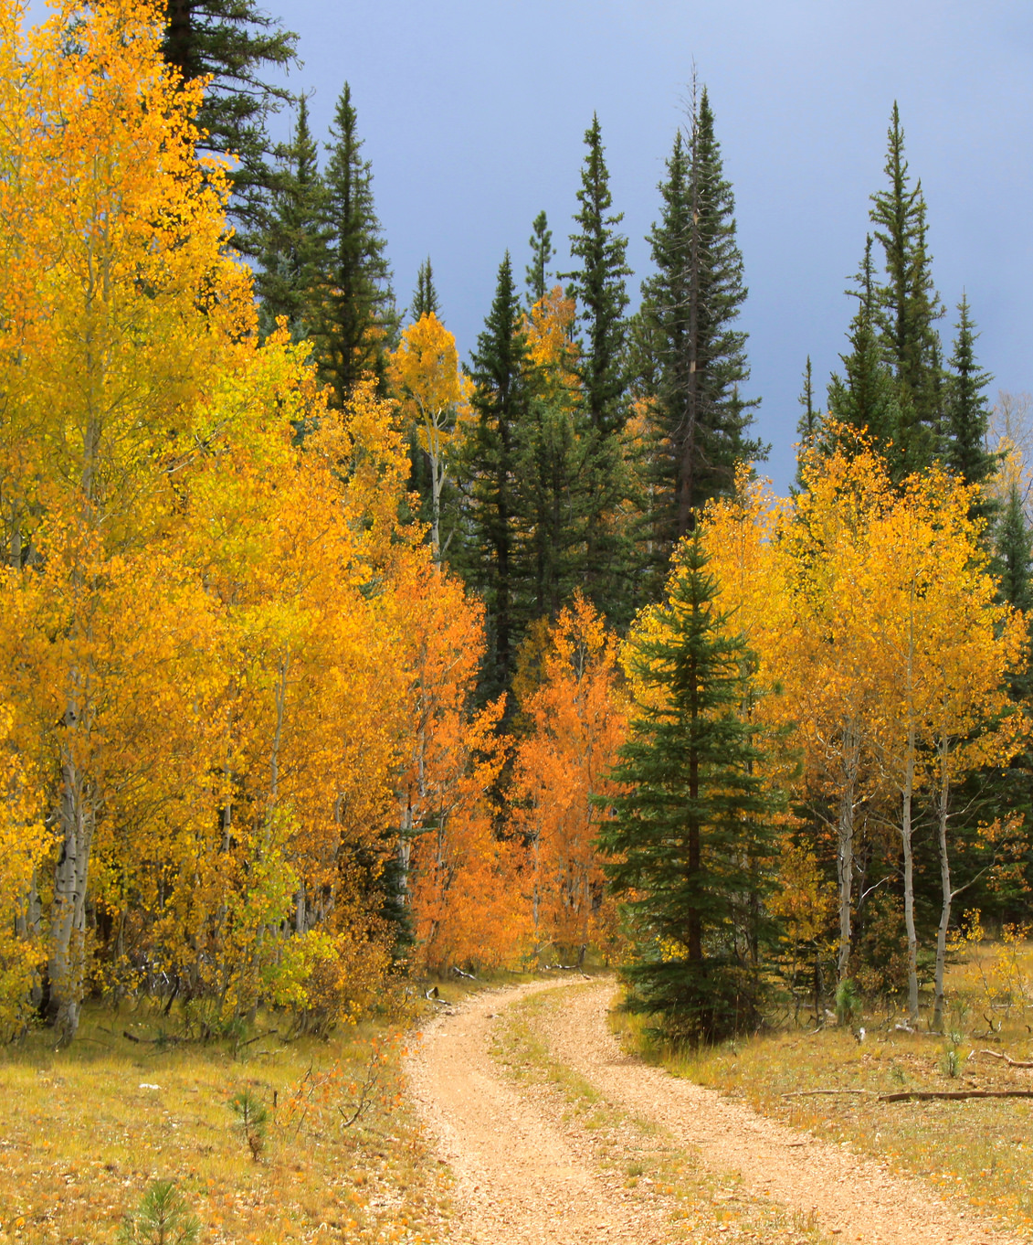
In Closing
The Strategic Plan gives guidance and structure for all the Region does; it's a terrific touchstone to remind us of the Big Why
The Strategic Plan provides important context for all that the Region does – both internally and to our Partners and Publics
Each area of the Region will have different approaches, given the resources they manage
Notes:
What Does this Mean for You?
The strategic plan gives guidance and structure for all you do; it is a terrific touchstone to remind us of the Big Why.
It is an umbrella plan, above your forest’s land management plan, and other more specific plans.
Each Forest will have different approaches, given the resources they manage.
Example: one outcome is on the Sonoran Desert – not all units have this.
As you are doing your program of work, the strategic plan will be your “north star.”
We are well-poised and in front of many regions because of this work.
I am excited about this and excited for the opportunities we have available to make a lasting impact on the Southwestern Region.
Partners: [RRC edited this slide for a more partner-centric focus.]

Slide 36
Questions?

