Slide 1
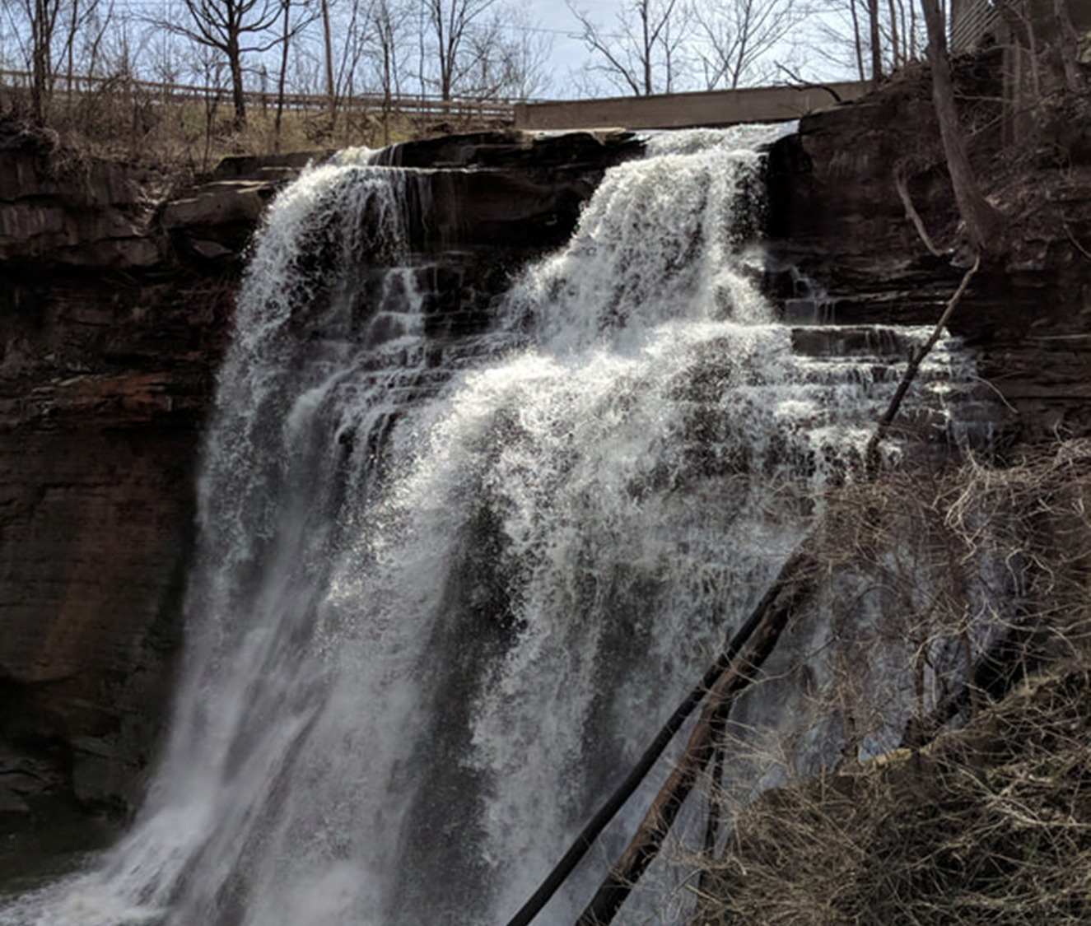
The RRC Governance Workshop
April – June 2022
Presented by Rebecca Reynolds
For the Southwestern Region, US Forest Service

Slide 2
Workshop Benefits
Use real governance situations to learn how to assess & re-tool
Work several areas so its easier to see the parallels
Working together, build a shared language & understanding
In the end, have a set of vetted products to share with the RLT

Slide 3
Potential Pitfalls
Using real situations (as opposed to generic examples) can activate frustrations about how things have been
Antidote: focus on what is needed now
Working across multiple real-time examples can feel confusing
Antidote: focus on identifying the governance needs in each
The ability to fix long-existing issues with some simple tools can strain credulity
Antidote: give it a try!

Slide 4
Some Governance Principles
Re-tooling governance depends on our ability to see what is desired (not re-hash the past)
Starting with Decision Space (rather than entities) enables us to better see what governance is needed
Consistency in governance is EVERYTHING – that’s why we use RRC tools

Slide 5
Learning Objectives
Understanding of Governance terms
Increased ability to assess Governance needs
Applied practice in developing Governance products
Applied practice in reviewing Governance products
Transform your ability to work with governance

Slide 6
Your Desired Outcomes
Round Robin: one thing you’d like to get from this workshop

Slide 7
How we’ll work
“Triage” each topic area, based on assessment results
Decide what governance product is needed:
Charter (for Group)
Role Description (for Individual)
SOP (Process)
Strategic Plan
Other?
Product Development Lead: using RRC tools, work with team to create a draft product for review
Rebecca is available to help, if desired! Also, email your draft products to Rebecca a day before the session that it will be reviewed.
Notes:
Leader’s Intent as a form of governance – as opposed to Policy

Slide 8
RRC Governance Resources
RRC webpage: https://www.RebeccaReynoldsConsulting.com/usfsr3.html
Governance Assessment Survey
please fill out PRIOR to each Workshop topic
RRC Tools
Charter Template
Role Description Template
SOP Development Tool
Strategic Plan Template
Background Docs
Governance Terms Defined
Jan RLT Governance Session PPT

Slide 9
Schedule
Session Date | Topic | Prod Dev Leads | Draft Prod Due
1. April 14 | Gov Wkshp Intro: Our process, Gov Refresher, Role Description, Charter, SOP, Plan Templates | N/A | N/A
2. April 21 | Workforce Planning Triage | Heather, Kim | April 28
3. April 28 | Review Workforce Planning Prod | RLT Triage | Rita | May 5
4. May 5 | Review RLT Prod | RSAT Triage | Robert | May 19
5. May 12 | Wildfire Crisis Strat Triage (RLT Mtg) | Ian, Michelle | May 26
6. May 19 | Review RSAT Prod | Funding Triage | Dan F | May 26
7. May 26 | Review Funding & Wildfire Prod | Tech Strat Triage | Mark J/Shayne | June 2
8. June 2 | Review Tech Strat Prod | Other Triage | TBD | June 9
9. June 9 | Review Outstanding Governance Products
10. June 16 | Wrap-Up of Gov Products & Prep Presentation to RLT
Notes:
RLT 64% Workforce Planning 46% Funding (Regional level) 43% RSAT 43% IIJA 36% 4 FRI 32% Line - Staff 11% Other 7% ELT 4% IT 4%

Slide 10
REVIEW: Governance Mechanics & Terminology
Notes:
Governance is a habit. To get the organization back to respecting its own governance (as core to its culture) is imperative for a healthy organization. First step: making “governance” a known part of the organizational lexicon – if we don’t know what it is, we can’t talk about it, fix it, or ensure it is working and being followed.
Is there a simpler word for GOVERNANCE? We could use structure or process – but there are many structures and processes within an org – so, we could use “decision-making structure and process,” but now we might as well us “governance” since it is one word that means just that!

Slide 11
Underperforming Governance can be fixed!
Assess existing governance
Revise existing or create new governance
Document with care
Communicate the change to those governed
Adhere & hold accountable to new governance
Notes:
Before leaders can do the above, understanding core concepts & terminology is key

Slide 12
Governance is not one thing
Overall Governance Type
Decision Space: grouping of decisions
Governance Purpose, Authority & Roles for each Decision Space
Governing Entities that fulfill the Roles in a Decision Space
Governance Documentation (Rules, Policy, Plans, Charters, SOP, etc.)
Ongoing Process for Governance Assessment & Redesign
Regularized Communication about Governance changes
Accountability Protocol to ensure adherence to established Governance
A good governance strategy requires a systematic approach…and is not benefitted by hurry!

Slide 13
Ad Hoc Governance
The proliferation of ad hoc governance in an organization creates confusion & inefficiency
Overlap
Gap
This can lead to low morale, tension,
and at worst, conflict!
Duplication
Notes:
Common pitfalls in addressing governance:
Standing up new entities in a rush without a thorough understanding/agreement of what is being governed
To restructure the organization, lines of authority, etc without the basis for it – a shared view of what is to be governed (decision space)
What does leadership need to build effective governance? First, to know that governance is built for a specific situation – one approach that works well here may not work as well there.

Slide 14
A Strategic Approach to Governance
Start with the decisions: define the decision space (what is being governed?)
Consider the context: what is exerting influence on the decision space
Decide on the type of governance best suited to the decision space
Then address the particulars of purpose, authority, roles, etc.
TIP: design governance as simply as possible & push decisions down
Notes:
Starting with the decisions means governance will be more about that than the people
If we start the individual, then we ask What does s/he get to decide?

Slide 15
Defining Decision Space
What are the
decisions about?
What is the reach of the decisions?
Content
Scope
DECISION
SPACE
Time
What is the timeframe of the decisions?
Notes:
Governance is built for specific decision space.
Scope: extent or range of view, outlook, application, operation, effectiveness.

Slide 16
Decision Space
Larger, more complex decision space is made manageable by grouping decisions into subsets
Groupings of decisions similar in content, scope, and timeframe
Grouping similar sets of decisions together is an effective way to streamline governance
NOTE:
More decision subsets make for easier decision-making but more complex governance
Fewer decision subsets make for simpler governance but more complex decision-making
Notes:
Example: The agency groups decisions in subsets based on geography – thus there are seven regions, which each govern their territory. This is an example of a fundamental principle of governance.
Decisions are also based on subject matter (content) – so, funding decisions, HR decisions, technology decisions, etc. The notion of centralized vs decentralized operates here – which decisions are made at what organizational level – without clarity this can be a source of confusion and annoyance.
Note: Each decision space does not necessarily have a different governing body – e.g., the RLT handles many subsets of decisions

Slide 17
Decision Space Context
CONTEXT
World Forces
Scope
Beliefs
Content
DECISION
SPACE
Time
Understanding
Values
Notes:
Decision space is affected by context, could be constrained or it could be expanded.
The forces that affect the decision space
Our current understanding of the decision space & governance overall
Our culture – beliefs & values as informed by past experience
World forces: events & trends that impact the decision space
Social
Our industry/region & sector (i.e., government, natural resources/land management)
Economic

Slide 18
Governing Entity
The Governing Entity is the specific position or group that fulfills the Governance Roles (best match to the Role Attributes)
E.g., The RLT is a Governing Entity, as are the positions of Regional Forester and District Ranger
Each of these entities may fulfill one or more Governing Roles in a Decision Space – for example:
The RLT may act in the Advisor Role to the RF Decisionmaker Role
The RF may act in the Advisor Role to a District Ranger in the Decisionmaker Role
District Rangers may act in the Implementer Role to the RLT Decisionmaker Role
Notes:
The trick here is distinguish between the position and the Role – Position does not always equate to the same role in every decision space – why? Because not every position is suited to the Role attributes required for every decision space!
If decision-maker role needs to be collective and involve stakeholders, a certain kind of entity will be required
If decision-maker role needs to be one SME, that will indicate a certain position

Slide 19
Documenting Governance
Documentation is paramount for new governance & for major decision spaces
Governance documents should be templatized for consistency & ease of understanding
Standard governance documents include:
Policy Charter
Strategic Plan Role Description
SOP Org Chart
Notes:
If every charter is written differently, it makes for inconsistent governance as well as overly onerous understanding of them.
Organizational Chart: the visual representation of the decision space governance positions/entities and their relationship (hierarchy) to each other – this map helps to ensure flow is clear and efficient

Slide 20
Governance Redesign Tips Since we are not starting fresh, all governance work is redesign!
Stand up new Governing Entities with care – once these are established, they’re hard to dismantle
Keep Governance SIMPLE – more is not better
Take extra care delegating authority, especially for decision-making
Utilize time-bounded Governance – to avoid proliferation & test it
Establish contingency governance for emergencies (which should be the exception; not the rule!)
Notes:
Bullet 1:
Governance entities may protect their decision space – be ready
Don’t get to the governance entity too quickly – that’s the easy part
Final bullet:
What is the fallback governance if the designed governance does not work or is not yet developed?
All governance should describe an alternate plan for decision-making, should the chosen method fail for some reason or some unexpected change emerges that calls for new governance
Generally, the governance fallback is to the Authority from whom the decision rights came
However, this does not have to be the case
Another option would be to give the decision rights to a position or another entity – short-term assignment until lasting governance can be developed (or fixed)

Slide 21
Communication
Since governance is often invisible and not well understood, establishing standardized communication about governance changes helps!
Key Governance Messages:
Governance is an evolving & critical element of the organization
Changes are to be expected as the natural course of business
Keeping up-to-date makes one’s job easier
This Photo by Unknown Author is licensed under CC BY-NC-ND
Notes:
Governance about governance communication!
Explicit attention to governance may seem foreign – and it is, if the organization is doing it for the first time. But whether an organization addresses governance explicitly or not, it is still operating. By not dealing with it, it doesn’t go away – like the plumbing in your home – it is there, whether you are aware of it or not. Helping our workforce to understand the basics of what governance is and some language to adeptly discuss it means that governance issues can be identified and remedied before they become bigger problems.

Slide 22
Adherence to established Governance
If governance is routinely ignored, this indicates that adherence is not being taken seriously
This is rectified by:
Standardized & official communication regarding governance
Integrating new/redesigned governance into the existing governance framework/processes
Creating new accountability protocols, as necessary
Notes:
Leadership vigilance / rigor – governance is a habit. To get the organization back to respecting its own governance (as core to its culture) is imperative for a healthy organization. First step: making “governance” a known part of the organizational lexicon – if we don’t know what it is, we can’t talk about it, fix it, or ensure it is working and being followed.

Slide 23
In Sum: Under-performing Governance can be fixed!
First step: learn the mechanics/terminology of governance
Second: learn to assess so governance is fixed where needed
Third: revise governance as indicated; document well
Fourth: communicate changes to those governed (affected)
Fifth: adhere rigorously to established governance, especially when it’s new
Sixth: watch for signs that it’s time to re-tool again!

Slide 24
Questions
15 Minute Break
Review 2 RRC Governance Tools: Charter Template & SOP Development

Slide 25
What’s Next?
TOPIC: Workforce Planning
Thurs, April 21st 9 AM – Noon MDT
Remember to fill out your assessment!

Slide 26
Thank you!

